Slide 1
Predictive Analysis Bankruptcy
Suhasini Ramachandran
suhasinier@gmail.com

Slide 2
Project analysis slide 2
Bankruptcy Analysis
Metrics & Interpretation
Problem Statement
Bankruptcy
Predictive Models
Objective
EDA
Data Facts

Slide 3
Project analysis slide 3
Problem Statement
Bankruptcy - Serious issue in the current scenario of global financial crisis and recession
Risks – Investors face loss when stock price of the company goes down and employees will be laid off
PROBLEM STATEMENT & OBJECTIVE
DATA FACTS
EDA
Classification Models
Metrics & Interpretation
No missing data
No duplicate values
10% outliers.
Non unique column – “ Liability-Assests Flag”
Imbalanced data
Standard Scaling of data
Source - Taiwan Economic Journal 1999 to 2009
Predictor variables – Numerical - 94
Target variable Categorical (Nominal)– 1,0
Logistic Regression
K Nearest Neighbor
Decision Tree
Random Forest
Gradient Boost
Support Vector Machine
Designing an ML model to predict the bankruptcy
Accuracy score
Precision
Recall
F1 score
ROC-AUC
.

Slide 4
Project analysis slide 3
Bankruptcy Analysis
OBJECTIVE
DATA FACTS
EDA
Predictive Models
Metrics & Interpretation
Handling missing values, duplicate values, outliers , unique columns, data imbalance, scaling and dimension reduction
Source - Taiwan Economic Journal 1999 to 2009
Predictor variables – Numerical - 94
Target variable Categorical (Nominal)– 1,0
Logistic Regression
K Nearest Neighbor
Decision Tree
Random Forest
Gradient Boost
Support Vector Machine
Designing an ML model to predict the bankruptcy
Accuracy score
Precision
Recall
F1 score
ROC-AUC
.

Slide 5
Project analysis slide 3
Exploratory Data Analysis (EDA)
No missing data
No duplicate values
Non unique column – “Liability-Assets Flag"
99.9 % of values are all 0s and this column is dropped
Around 10% outliers are present
Imputed using IQR method
Data is imbalanced
SMOTE sampling is used
Feature Scaling
Standard Scaling applied
Dimensionality Reduction
Principal Component Analysis (n_components = 20 to 50 )
PROBLEM STATEMENT & OBJECTIVE
DATA FACTS
EDA
Classification Models
Metrics & Interpretation
No missing data
No duplicate values
10% outliers.
Non unique column – “ Liability-Assests Flag”
Imbalanced data
Standard Scaling of data
Source - Taiwan Economic Journal 1999 to 2009
Predictor variables – Numerical - 94
Target variable Categorical (Nominal)– 1,0
Logistic Regression
K Nearest Neighbor
Decision Tree
Random Forest
Gradient Boost
Support Vector Machine
Designing an ML model to predict the bankruptcy
Accuracy score
Precision
Recall
F1 score
ROC-AUC
.

Slide 6
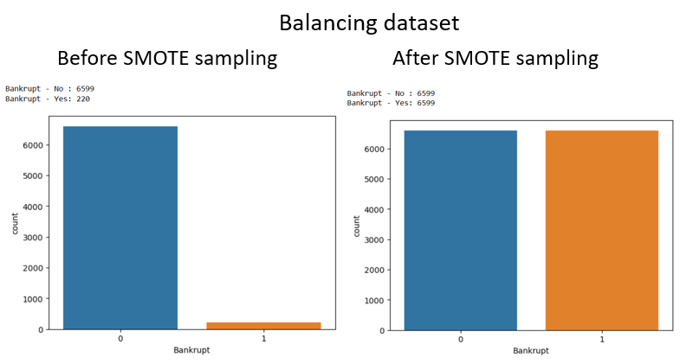
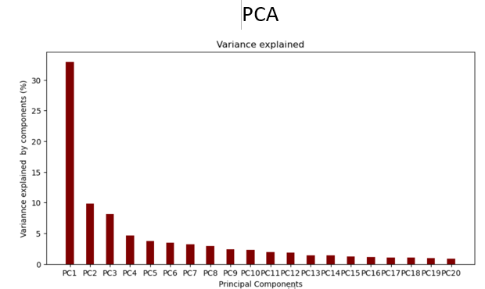
Project analysis slide 10
EDA (Data Imbalance & PCA)
EDA
No missing data
No duplicate values
10% outliers imputed with IQR method
Non unique column – “ Liability-Assests Flag” - dropped
Imbalanced data
Standard Scaling of data

Slide 8
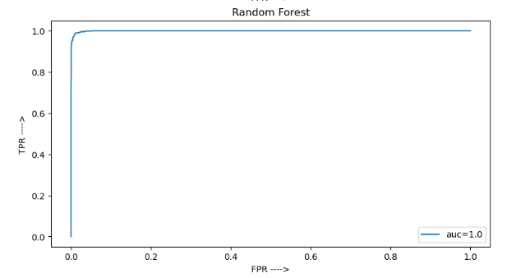
Project analysis slide 11
Conclusion
ROC – AUC curve
Applying PCA technique on the dataset has shown no improvement on results
Out of 6 models used , Random Forest (on original data) has produced good results with high accuracy score , Precision , Recall F1 score and AUC

Slide 9
Thank You

